Slide 1
Deep Learning - Design proposal

Slide 2
High Level Network Architecture Diagram
Customer Up-Links
1 GbE
2x1G
10 GbE
Master/Deployer (8001-12C)
2x10G
Per Storage Node
2x10G DAC Cables
2x 1G Cat5e Cables
OS provisioning
Storage – S822LC (8001-22C)
Storage
IPMI
Per Compute Node
2x10G DAC Cables
2x 1G Cat5e Cables
OS provisioning
Ceph block
(OSD)
Storage/Tensor
Ceph block
(OSD)
Compute - 8335-GTB
IPMI
Tensor
Lenovo G8052
Lenovo G8264CS
EDR IB
Optional EDR Infiniband
for Tensor communication

Slide 3
Management Server
Optional Infiniband
NVLink Servers
Storage Server

Slide 4
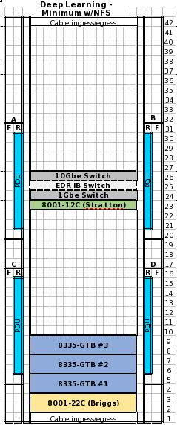
Racking / Minimal Configuration
Network:
1 x Lenovo G8264CS (10G data network)
1*x Lenovo G8052 (1G management network)
Rack:
QTY: 1
SlimRack 7965-94Y
PDUs
Compute Node:
QTY: 3
Server Config:
Minsky 8335GTB (2U)
Processor – POWER8 10 Cores ( 3.492Ghz)
GPU – 4 x Nvidia GP100
Memory – 512 GB ,
2 x 3.8TB Sata HDDs
1 x PCIe2 10GbE SFP+ CU 4-port converged network adapter
Option: 3.2TB NVMe Flash Storage
Network Option:
1 x Mellanox (EDR IB data network)
Master/Deployment Node:
QTY: 1
Stratton S821LC (8001-12C)
Should support any Power8-LC system
Storage Node:
QTY: 1
Server Config:
Briggs 822LC (2U)
Processor – POWER8 10 Cores ( 3.492Ghz)
Memory – 256 GB ,
12 x 3.8TB Sata HDDs
1 x PCIe2 10GbE SFP+ CU 4-port converged network adapter

Slide 5
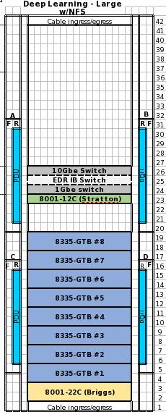
Racking / Large Configuration
Network:
1 x Lenovo G8264CS (10G data network)
1*x Lenovo G8052 (1G management network)
Rack:
QTY: 1
SlimRack 7965-94Y
PDUs
Compute Node:
QTY: 8
Server Config:
Minsky 8335GTB (2U)
Processor – POWER8 10 Cores ( 3.492Ghz)
GPU – 4 x Nvidia GP100
Memory – 512 GB ,
2 x 3.8TB Sata HDDs
1 x PCIe2 10GbE SFP+ CU 4-port converged network adapter
Option: 3.2TB NVMe Flash Storage
Network Option:
1 x Mellanox (EDR IB data network)
Master/Deployment Node:
QTY: 1
Stratton S821LC (8001-12C)
Should support any Power8-LC system
Storage Node:
QTY: 1
Server Config:
Briggs 822LC (2U)
Processor – POWER8 10 Cores ( 3.492Ghz)
Memory – 256 GB ,
12 x 3.8TB Sata HDDs
1 x PCIe2 10GbE SFP+ CU 4-port converged network adapter

Slide 6
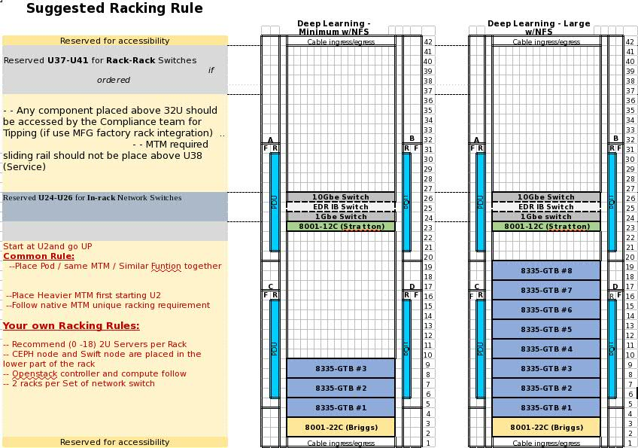

Slide 7
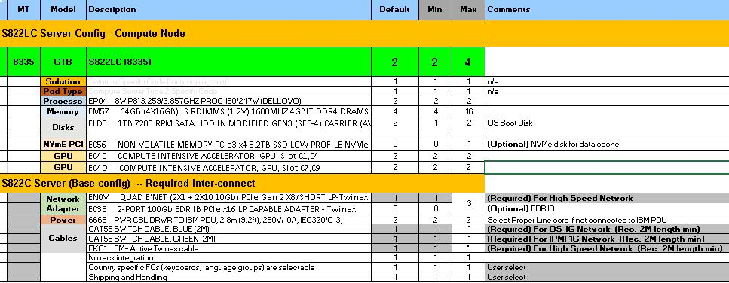

Slide 8
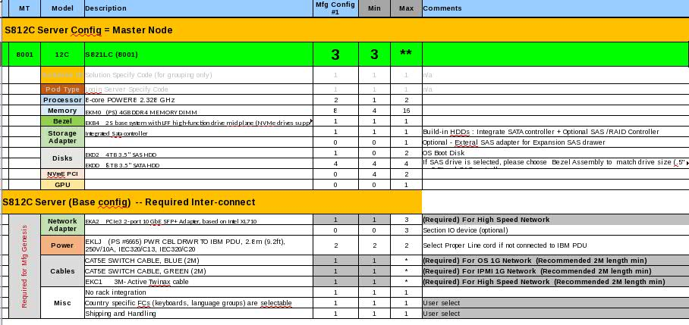

Slide 9
